Slide 1
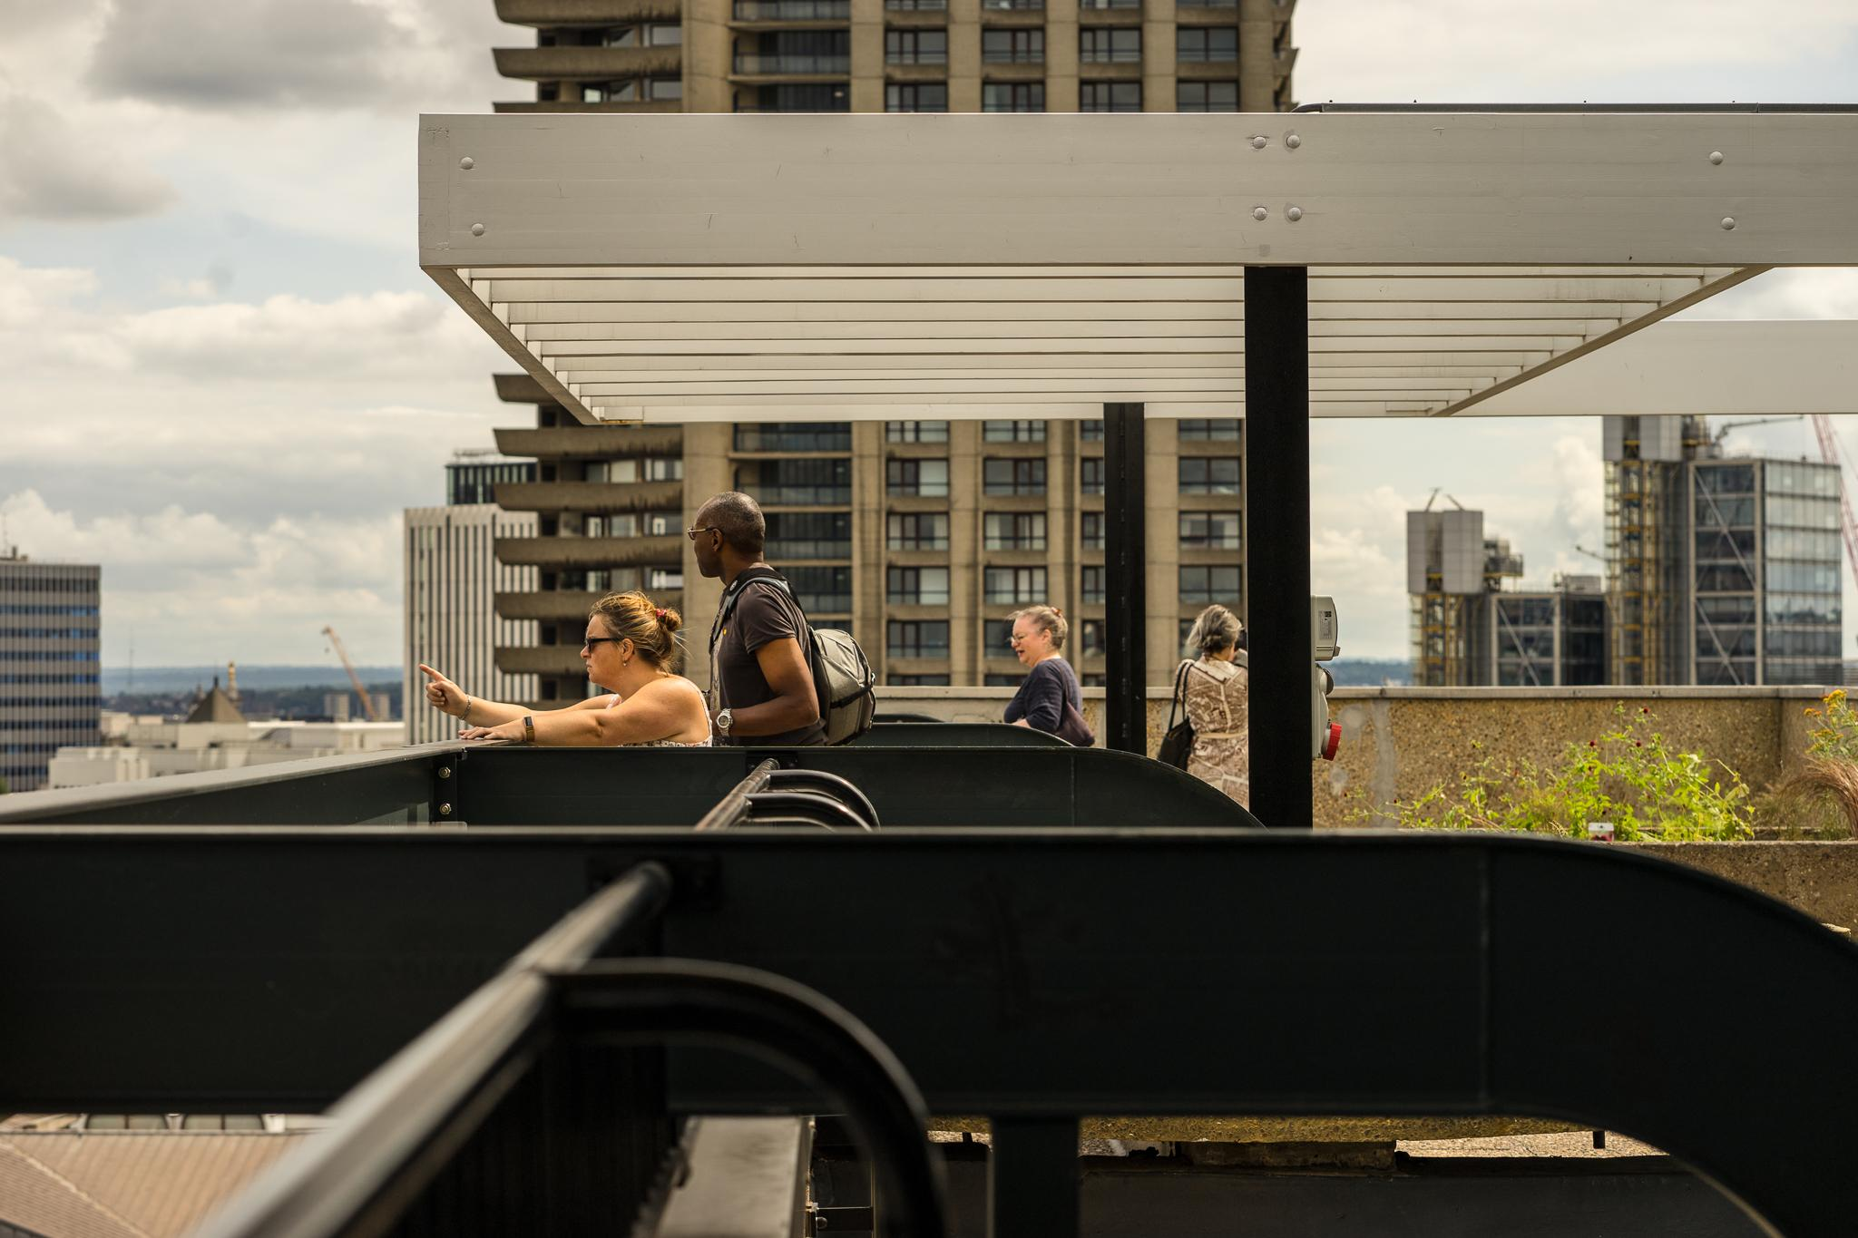
Completing an expression of interest for Open House Festival 2024

Slide 2
What is an expression of interest?
Do I need to complete one? Why?
How do I complete one?
What happens next?
Questions

Slide 3
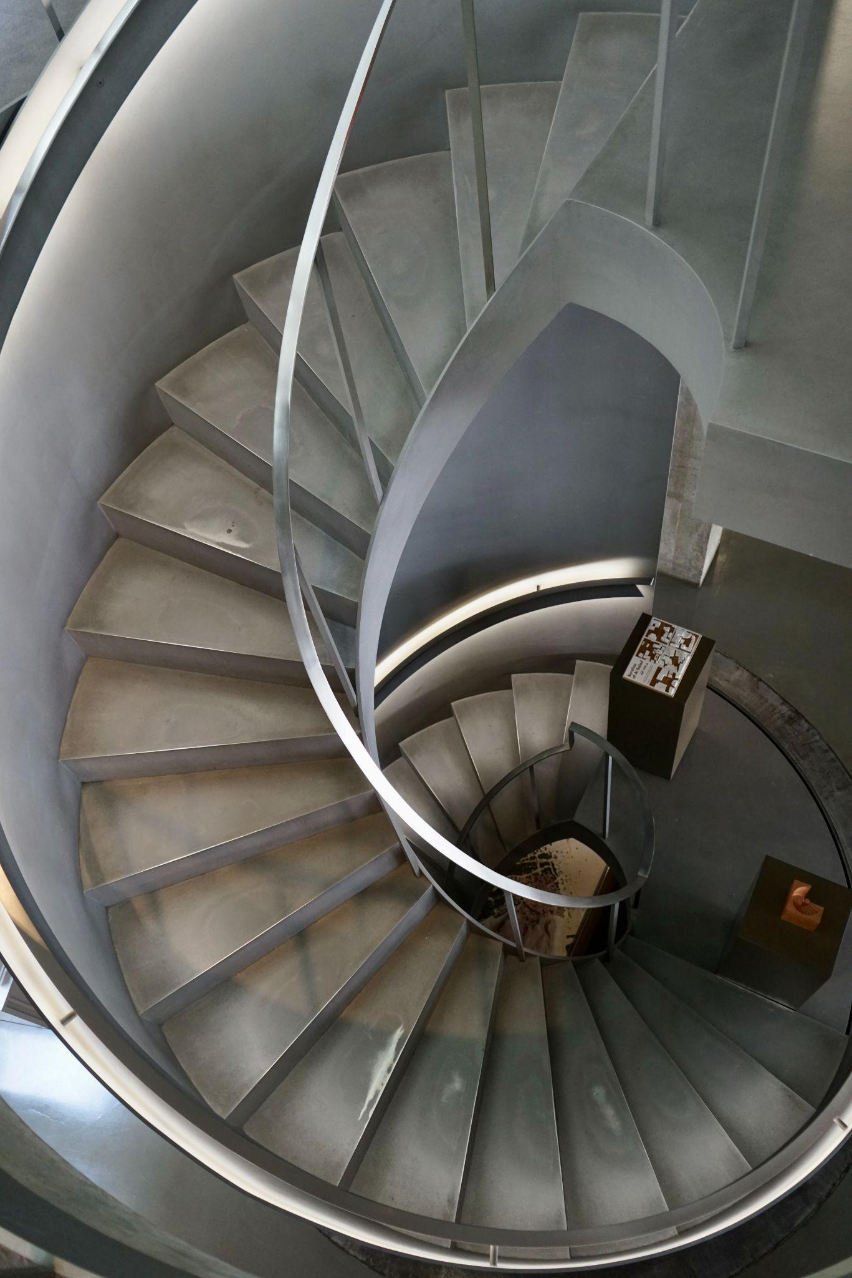
What is an expression of interest?
Short online form
Core information - name, location etc.
Additional questions - your plans

Slide 4
Do I need to complete an expression of interest?

Slide 5
Has your building or event been in the festival before?
If yes, you don’t need to complete one
If no, then you do

Slide 6
Why?
Opportunity for early feedback
Adding the listing to our database

Slide 7
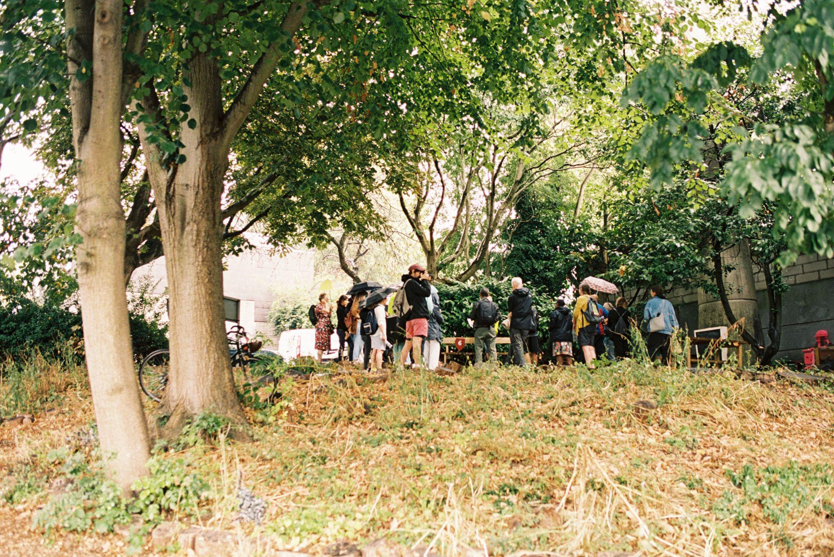
How?
https://programme.openhouse.org.uk/login

Slide 8
Things to help you
Webpage - https://open-city.org.uk/open-house-festival-2024
Video guide - https://open-city.org.uk/step-by-step
Written guide - https://rb.gy/y3y45z
Curatorial criteria - https://rb.gy/xo1woc

Slide 9
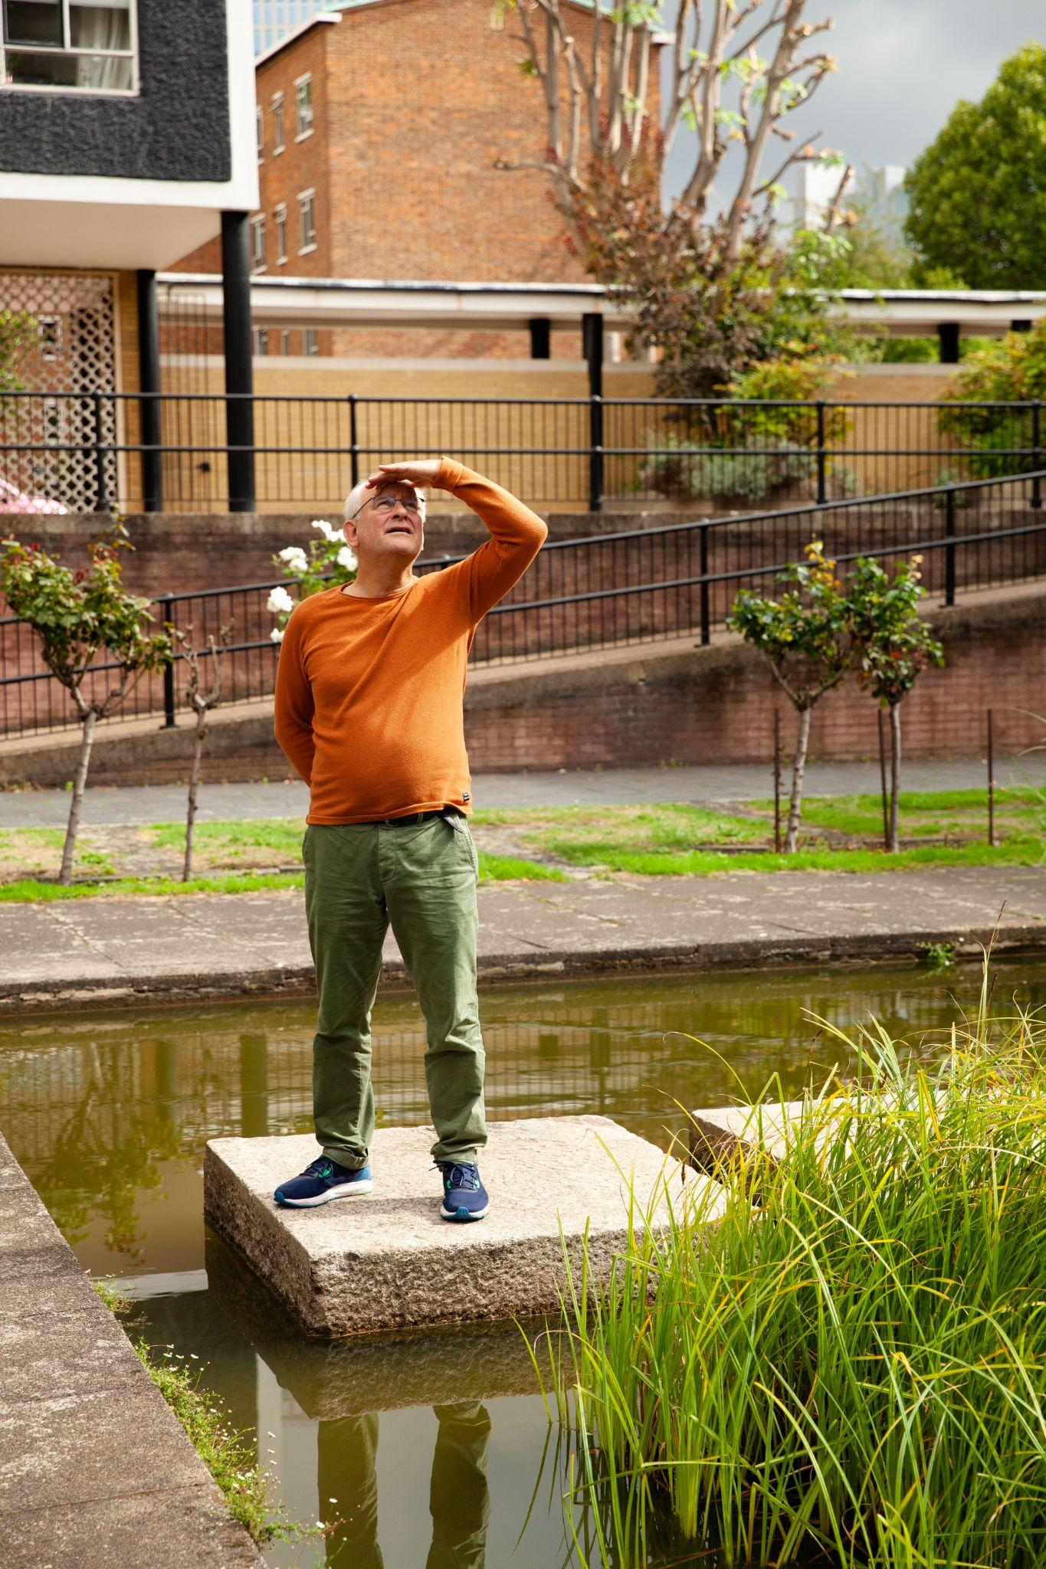
What happens next?
1 June
Deadline for expressions of interest
14 June
Our deadline for responding to you

Slide 10
What happens next?
Feedback resubmit
Approved application

Slide 11
What happens next?
Application form accessed via Dashboard
Deadline is 1 July

Slide 12
What happens next?
Programme preview - 18 July
Programme launch - 21 August

Slide 13
What happens next?
Open House Festival 2024
Saturday 14 - Sunday 22 September

Slide 14
Questions?

